Slide 1
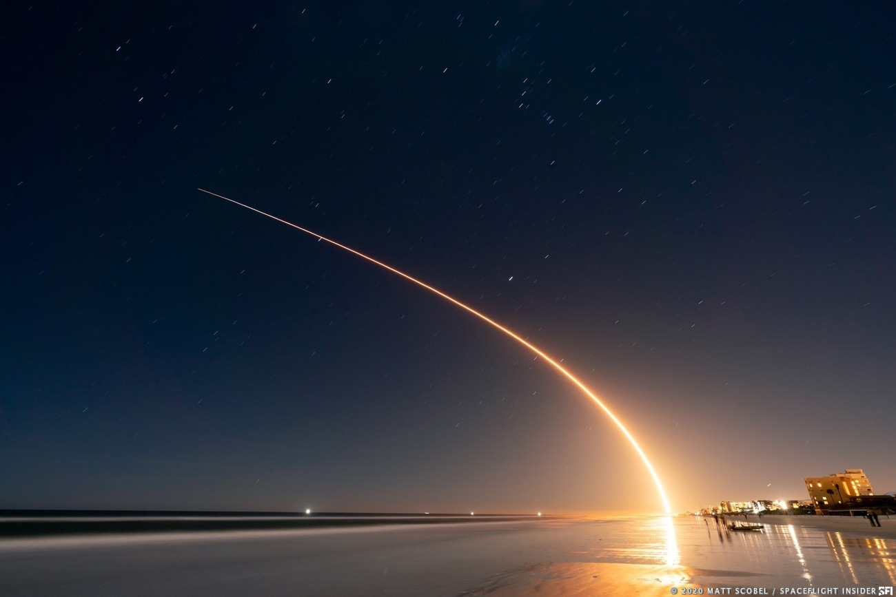

Winning Space Race
with Data Science
Stephane DEDIEU
June 2nd, 2022

Slide 2
Important Preliminary remarks for reviewers.
Stéphane Dedieu, June 21st, 2022
I have no IBM cloud account anymore.
Interactive dashboard: I could not find any good solution for sharing the interactive Plotly Dashboard: MyBinder doesn’t work. Google Colab is good but…
-if the interactive dashboard works very well with Google Colab (click on Colab icon in GitHub PlotlyDash notebook), exploring the Dashboard requires a GoogleDrive account for running the code (option “run after”). Insist on cell [9] there maybe an issue with “import dash”. Run twice, it works.
-You can import the notebook and run it on your computer if you installed Anaconda or any similar tool. In the application, you may need to replace: app = JupyterDash(__name__); JupyterDash.infer_jupyter_proxy_config() (for Google Colab) with initial: app = dash.Dash(__name__)
Interactive launch site maps notebook with Folium works very well with nbviewer
Other notebooks in GitHub properly display dataframes and results.
SQL queries: I built my own MySQL server, imported the .csv file in a Table, established a connection with my MySQL server, and used pandas sql queries in the form: pd.read_sql_query… because this was the solution that worked best.
Regarding the report, SQL queries were disruptive and I moved most of them to Appendix. Some SQL queries that were useful to the report are contextualized in the Results sections.
Machine learning prediction: with default train test split, results were basically all similar. And boring. I shuffled the data set using the option random_state. With random_state=3, results are more diverse. And they are reproducible, except Decision Tree.
X_train, X_test, Y_train, Y_test = train_test_split( X, Y, test_size=0.2, random_state=3)

Slide 3

Outline
Executive Summary
Introduction
Methodology
Results
Conclusions
Appendix

Slide 4
Executive Summary
In a highly competitive business environment:
SpaceX has revolutionized the launch of satellites with a concept of reusable launcher/booster: Falcon9/Falcon 9 Heavy
The main advantage of this concept is the significant reduction in cost per kg.
Reliability problems remain compared to classic launch vehicles like Soyuz or Ariane-5.
For maintaining the “low cost” competitive advantage, compared with classic launchers, Falcon9 mission success is defined as the successful recovery or landing of the booster.
Falcon9 booster successful recovery depends on features such as:
orbit
payload mass
booster versions
Launching sites…
Based on these features, the best Machine Learning supervised classification model developed in this report, predicted booster recovery outcome with an accuracy close to 94%.

Slide 5
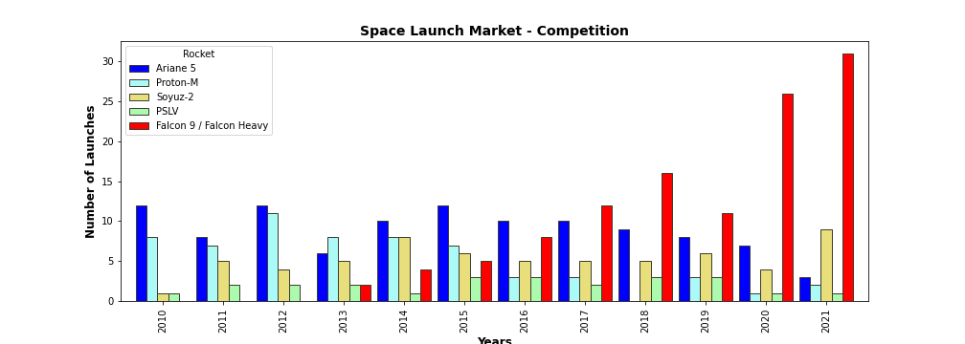
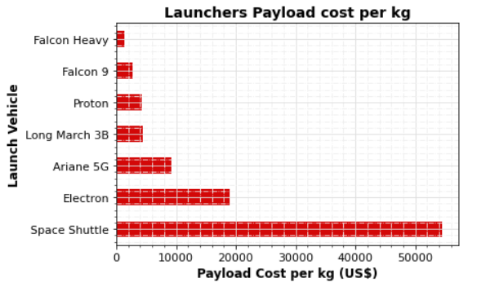
Introduction - Business understanding
Commercial rocket launches is a very competitive market.
From 2000 to 2017, Ariane 5 (ESA - Arianespace) dominated the market with: lower cost, high payload mass, reliability.
In terms of cost, China, India, Russia are tough competitors with less reliable classic launchers like LongMarch, Proton, Soyuz-2, PSLV. New players like BlueHorizon are still in early stage.
Since 2017, SpaceX Falcon9/Falcon9 Heavt is increasingly dominating the market with better cost per kg thanks to the reusable booster concept.
Competition may heat up again with the advent of Ariane 6 and SpaceX Starship.

Slide 6
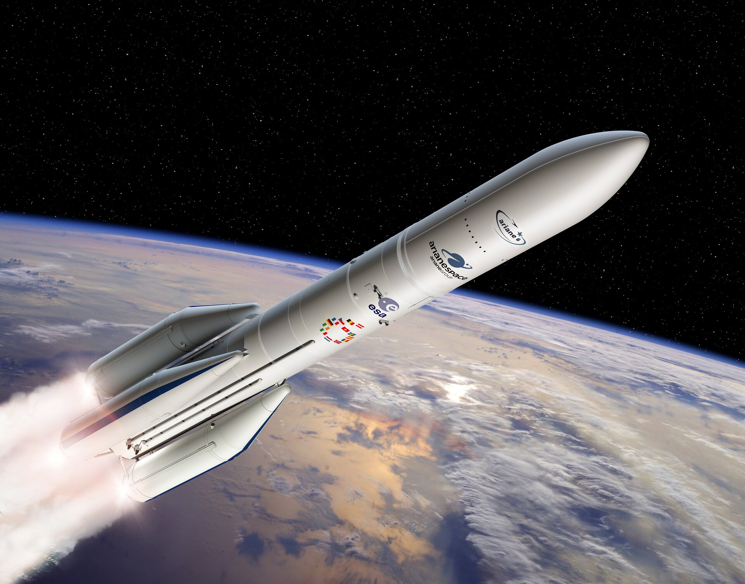
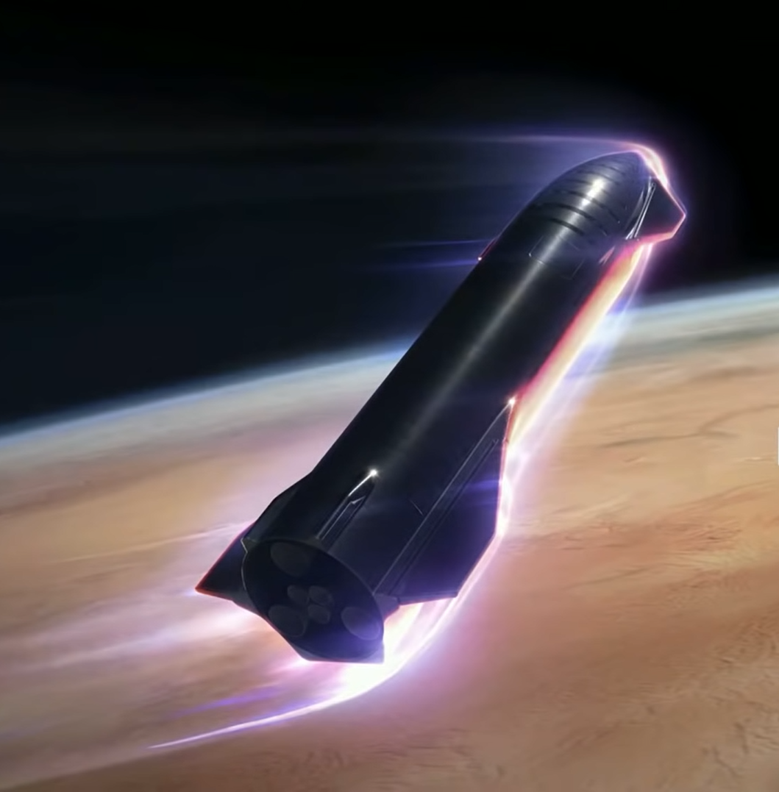
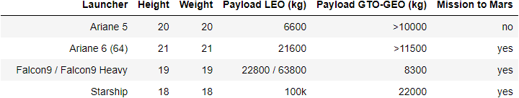
Introduction - Business understanding
Falcon 9/Falcon9 heavy v. Ariane 6
Falcon9 / Falcon 9 Heavy can easily compete with new Ariane 6 (2 or 4 boosters) in terms of:
Cost per kg
Payload mass
SpaceX Starship will further crush the competition in both domains.
Falcon9 and Starship costs are way lower due to reuse of boosters
Ariane-6 will be a classic launcher for reliability purposes
Falcon9 reliability can’t compete with Ariane-5G record
Falcon9 booster recovery success rate is still an issue.
Ariane 64 (4 boosters) SpaceX Starship

Slide 7
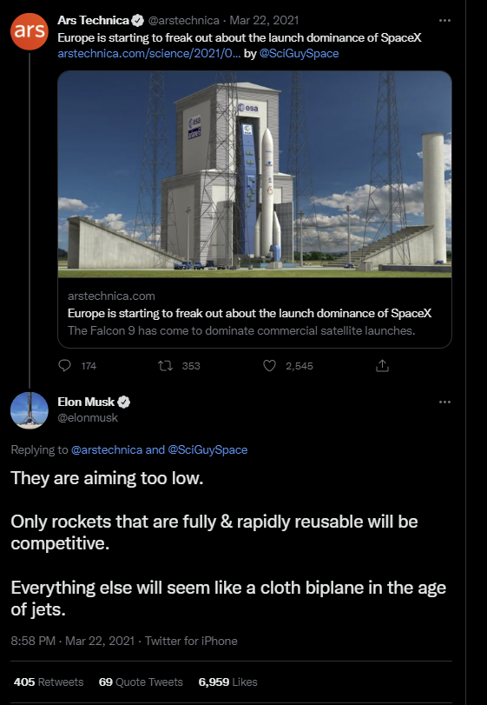
Introduction - Business understanding
SpaceX CEO Elon Musk has criticized European efforts in the emergent new space race. In March 2021, he wrote on Twitter:
“They are aiming too low. Only rockets that are fully & rapidly reusable will be competitive. Everything else will seem like a cloth biplane in the age of jets.”
Reliability v. Risky concept: “reusability” and Significant cost reduction
SpaceX financial viability heavily depends on the successful landing of the booster (booster recovery) defined as “mission success”.
Using SpaceX Falcon9 database, we develop AI tools:
for visualizing, analyzing features conditioning mission success
for predicting Falcon 9 success and SpaceX financial viability using supervised classification algorithms.

Slide 8
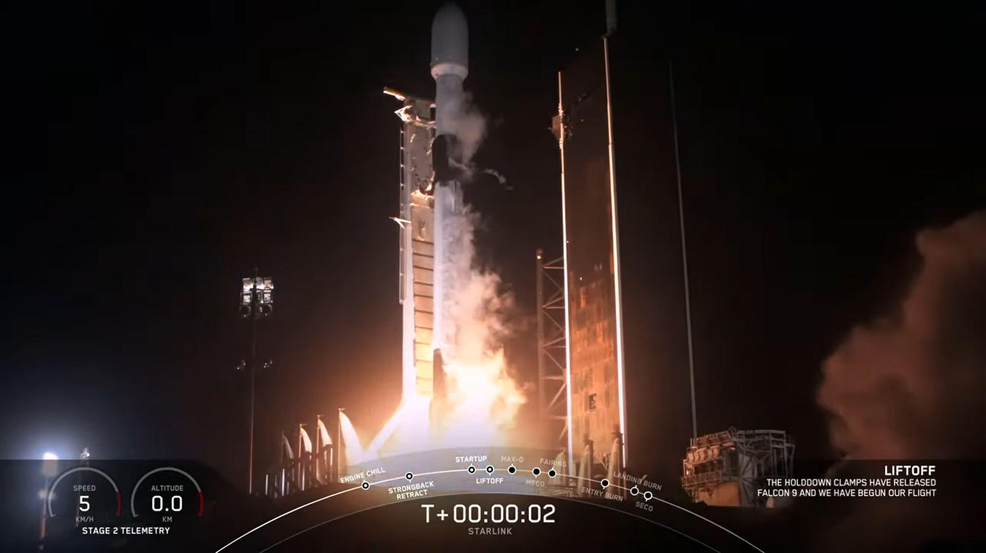
Section 1
Methodology

Slide 9
Methodology
Methodology steps:
1. Data collection from open Data base and Wikipedia (Falcon9, Ariane-5).
2. Data wrangling.
3. Exploratory data analysis using SQL query and visualization of correlation between parameters.
4. Visual analytics: launch sites with Folium, success rates with Plotly Dash.
5. Classification Models development and validations. Selection of best predictive model.

Slide 10
Data Collection
SpaceX REST API
Web scraping Wikipedia
Data was collected from:
-open source SpaceX REST API
-webscraping Falcon9 launch data in Wikipedia
-webscraping Ariane5 launcher data in Wikipedia for reference graphs only. (not prepared for ML)
Requested and parsed SpaceX launch data
Get URL response
Restricted dataframe to Falcon 9 launches
Extract Table data with Beautiful soup
Replaced missing payload value with mean value
Clean
Saved data into csv file
data_set_part1.csv
Saved data into csv file
data_set_part2.csv

Slide 11
Data Collection - Scraping
Acquired historical launch data from Wikipedia page 'List of Falcon 9 and Falcon Heavy Launches'
Requested the Falcon9 Launch Wiki page from its Wikipedia URL
Created a beautiful soup object
Found all tables.
Extracted all column/variable names from the HTML table header
Converted Dictionary to Dataframe
Saved in a Dictionary
Appended Data to Keys
Saved Dataframe into
.csv file
https://github.com/DrStef/Applied_Data_Science_Capstone/blob/main/GH_jupyter-labs-webscraping_v4.ipynb
https://github.com/DrStef/Applied_Data_Science_Capstone/blob/main/GH_jupyter-labs-webscraping_v4.ipynb

Slide 12
Data Collection – SpaceX API
Requested rocket launch data from SpaceX API
url=https://api.spacexdata.com/v4/launches/past
Requested and parsed
SpaceX data with GET request
Decoded response as a .json file
Turned it into Pandas dataframe
Preliminary Stage
We defined a series of functions helping the use the API to extract info using identification numbers (IDs) in the launch data.
getBoosterVersion(data)
getLaunchSite(data)
getPayloadData(data)
getCoreData(data)
Used the API with functions to get info from IDs:
BoosterVersion
Payloads
LaunchSite
Cores
Stored in List
Selected Falcon9 data only
Replaced missing payload mass value with mean
Assigned list to dictionary Converted to Dataframe
Saved Dataframe into
.csv file
https://github.com/DrStef/Applied_Data_Science_Capstone/blob/main/GH_jupyter-labs-spacex-data-collection-api_v5.ipynb

Slide 13
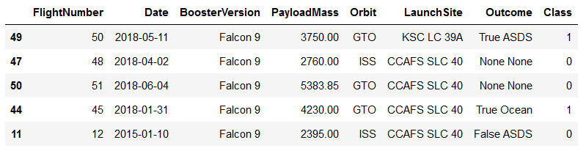
Data Wrangling
Dataframe
From SpaceX API
Identified missing values
Replaced missing “PayloadMass” value with mean value
Created a set of 1st stage booster landing outcomes
0 True ASDS: successful landing on a drone ship
1 None None: failure to land
2 True RTLS: successful landing to a ground pad
3 False ASDS: failed landing on a drone ship
4 True Ocean: successful landing, specific region of the ocean
5 False Ocean: failed landing, specific region of the ocean
6 None ASDS: failure to land
7 False RTLS: failed landing to a ground pad
SpaceX dataset
Further Data wrangling
Calculated:
Number of launches on each site
number and occurrence of each orbit
number and occurrence of missions outcome per orbit type
Identified:
null values for each feature
numerical and categorical features
Created a Training label: 'Class'
Class = 0: booster landing failure
Class = 1: booster landing success
https://github.com/DrStef/Applied_Data_Science_Capstone/blob/main/GH_labs-jupyter-spacex-Data%20wrangling_v3.ipynb

Slide 14
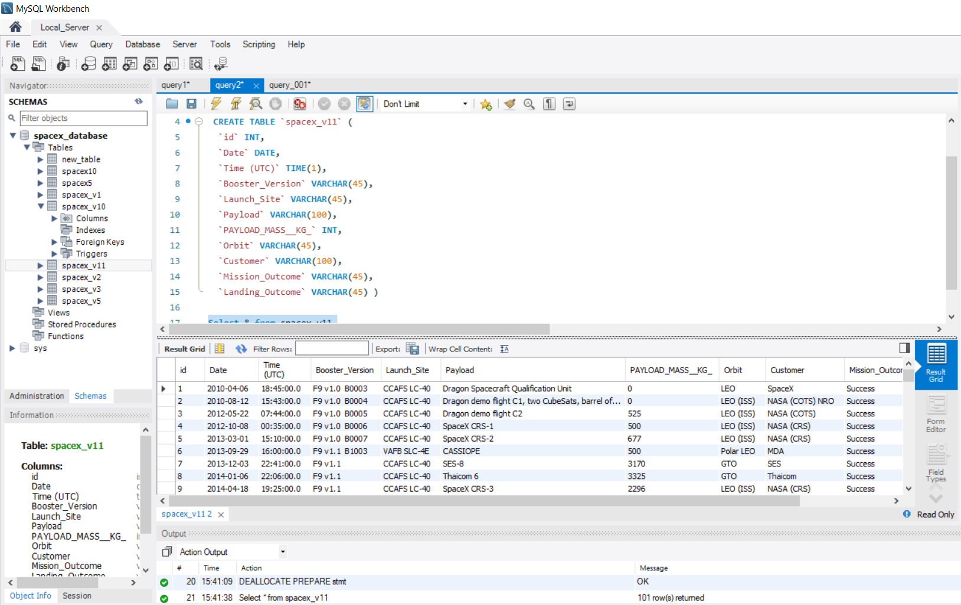
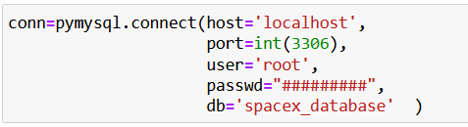
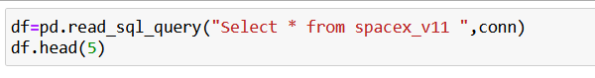
EDA with SQL
For the reviewer, for emulating SQL queries:
I created a MySQL local server
I created a database: 'spacex_database'
I saved SpaceX csv file in Table “spacex_v11” (see picture)
I established a connection “conn” wih “spacex_database”.
MySQL local server
Building “spacex_v11” table.
We ran SQL queries with “pd.read_sql_queries”:
1. to download data in a Jupyter Notebook (dataframe)
2. to display information about:
• Launch sites
• Payload mass
• Booster versions
• Mission outcomes
• Booster landings
https://github.com/DrStef/Applied_Data_Science_Capstone/blob/main/GH_jupyter-labs-eda-sql-coursera_v10.ipynb

Slide 15
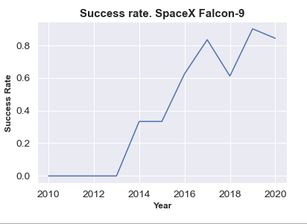
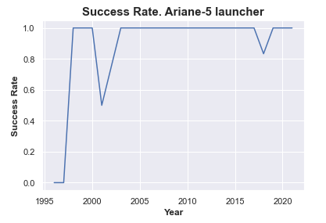
EDA with Data Visualization
Exploring data in the Falcon 9 dataframe searching for factors and relations influencing launching success rate (booster recovery).
Payload mass
Orbit type
Launch site
Graphs and scatter charts with Matplotlib – Seaborn and Analysis.
Results with Scatter charts are labeled: class 0-1 (failure/success).
Payload mass v. Flight Number
Launch Site v. Flight number
Launch Site v. Payload mass
Orbit v. Flight number
Orbit v. Payload mass
Histogram: success rate for each orbit
Falcon 9 & Ariane-5 launch success yearly trend.
https://github.com/DrStef/Applied_Data_Science_Capstone/blob/main/GH_jupyter-labs-eda-dataviz-v10.ipynb

Slide 16
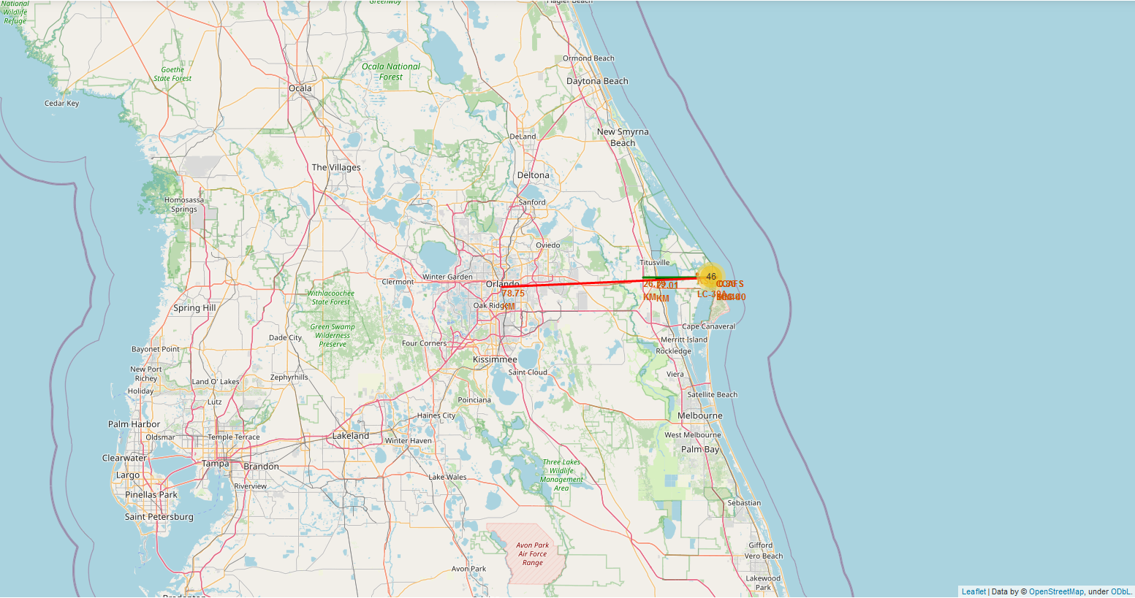
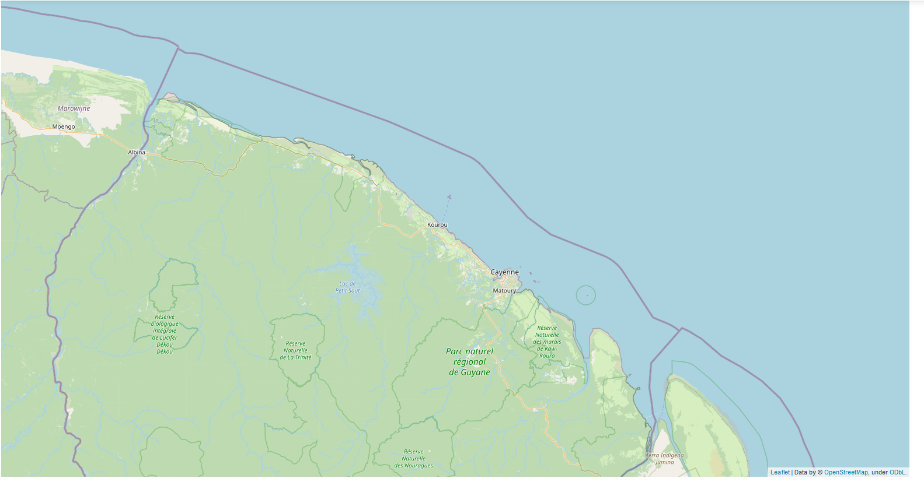
Build an Interactive Map with Folium
Launch success rate may depend on the location and proximity of a launch site. Folium Interactive Map was used for visualizing and analyzing SpaceX Launch Sites.
Used Interactive mapping library called Folium
Identified all SpaceX launch sites on a map: Florida, California
Included longitude and latitude info.
Identified successful/failed launches for each site on map
Calculated the distance between a launch site (CCAFS_SLC40 in Cape Canaveral, FL ) and:
Closest coastline
Closest high traffic density railway: Florida East Coast Railway
Closest high traffic density highway: Interstate I95
Closest high density urban area: Orlando (FL)
For reference, we added the localization of European Space Agency (ESA) /ArianeEspace Ariane 5 and Soyuz launch pads in Kourou, French Guiana.
CCAFS_SLC40 in Cape Canaveral FL
Coordinates: -80.577º, 28.563º
Ariane launch pad - Kourou in French Guiana
Coordinates: -52.792º, 5.265º (~ Equator)
https://nbviewer.org/github/DrStef/Applied_Data_Science_Capstone/blob/main/GH_lab_jupyter_launch_site_location_v4.ipynb

Slide 17
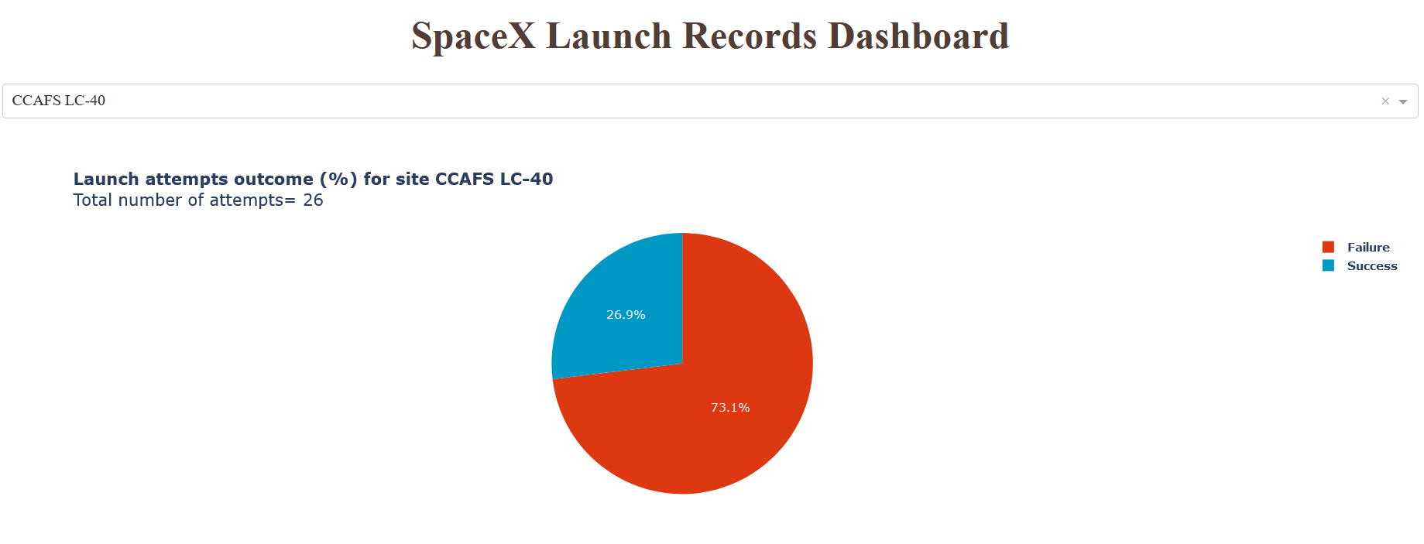
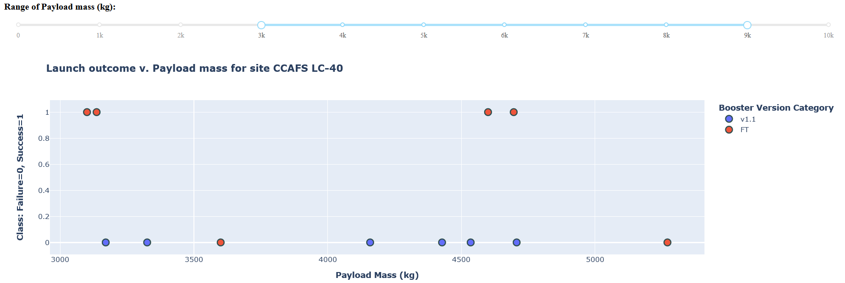
Build a Dashboard with Plotly Dash
We built an interactive dashboard with Plotly including:
Dropdown menu for selecting launch sites
Pie charts displaying success rate.
Scatter chart displaying launch site, payload mass, success/failure
Range slider for selecting range of payload mass (kg).
for analyzing SpaceX launch records features:
site with largest successful launches.
site with highest launch success rate
payload range(s) with highest launch success rate
payload range(s) with lowest launch success rate
F9 Booster version (v1.0, v1.1, FT, B4, B5, etc.) with highest launch success rate.
https://github.com/DrStef/Applied_Data_Science_Capstone/blob/main/GH_Build_a_Dashboard_Application_with_Plotly_Dash_v10.ipynb

Slide 18
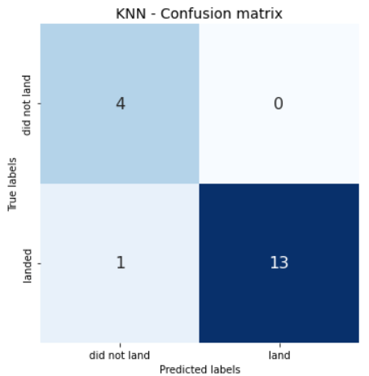
Predictive Analysis (Classification)
Model Training
Imported Falcon9 launching data from .csv to Pandas dataframe
Logistic Regression
Supervised Classification models
Launcher landing Labels
Class 0: fail
Class 1: success
Support Vector Machine (SVM)
Data normalization
Decision Tree
Classifier
Testing set
Split Data: Training, Testing Sets
Shuffling option !
Predictive analysis
Accuracy
Confusion matrix
K Nearest Neighbors
Classifier
Note to the reviewer:
Data was shuffled in the split data process. For making results a bit more interesting
“train_test_split( X, Y, test_size=0.2, random_state=3)”
Selection of best model
Optimization of models hyper-parameters with Scikit-learn GridSearchCV
Refined Optimization when possible (LR, SVM) for achieving highest accuracy with training set.
https://github.com/DrStef/Applied_Data_Science_Capstone/blob/main/GH_SpaceX_Machine%20Learning%20Prediction_Part_5_v8_shuffling.ipynb

Slide 19
Results
Exploratory data analysis results
Interactive analytics demo in screenshots
Predictive analysis results

Slide 20
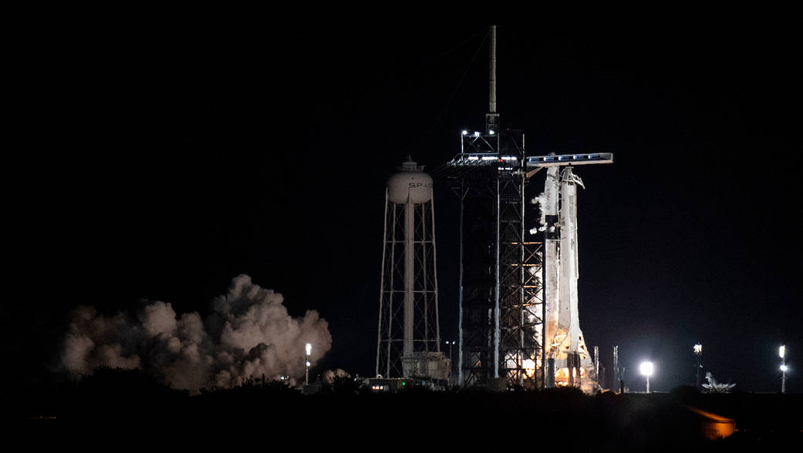
Section 2
Insights drawn from EDA

Slide 21
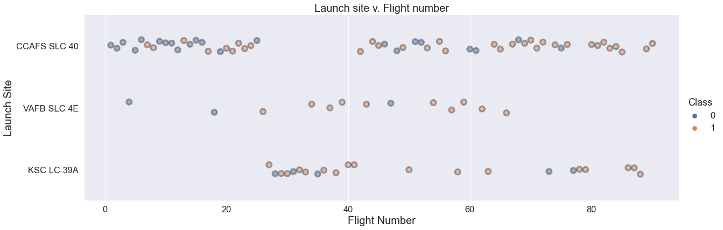
Launch Site v. Flight Number
The chart displays valuable info about:
Chronology: flight numbers
Number of flights per launch site
Success/Failure per launch site
Cape Canaveral CCAFS-SLC 40 is the most used launch site.
CCAFS-SLC 40 concentrates most of failures , particularly in the early stage of Falcon9 project.
Given CCAFS-SLC 40 southern location, most “risky” GTO and GEO launches may take place there.
Additional info needed: orbit, payload mass

Slide 22
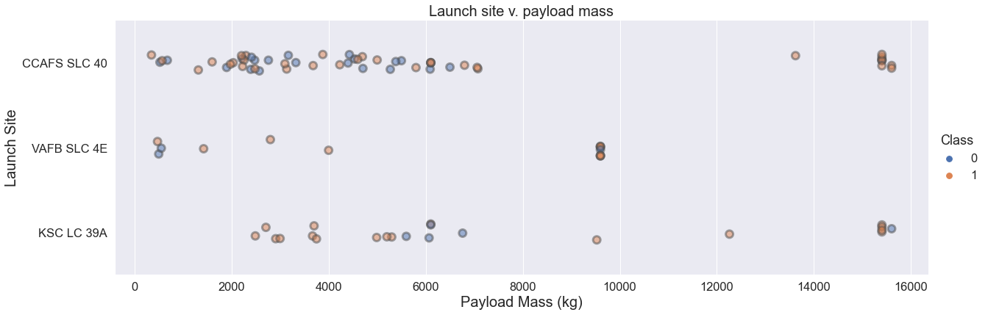
Launch Site v. Payload
The chart brings additional info:
Payload mass per launch site
Success/Failure per payload mass
Given Falcon9 specifications, heavy payloads > 10000 kg are sent to low/medium orbits LEO/MEO only.
It looks like the percentage of failures is lower for heavy payload. Which would indicate that low orbits are less risky to the success of the mission (recovery of booster).
Light payloads are not necessarily all sent to GTO/GEO.
More information is needed for extracting some correlation: success rate v. payload/orbit

Slide 23
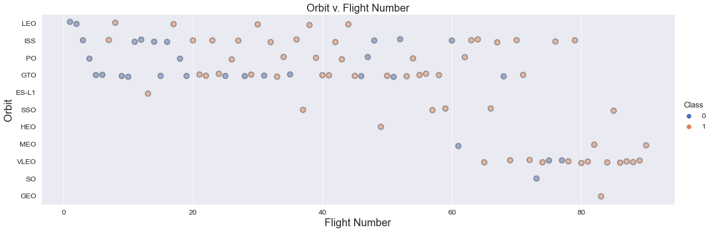
Orbit Type v. Flight Number
The chart brings additional info:
Number of flights per Orbit.
Success rate per orbit
The number of flights for: GEO, SO, HEO, ESL-1, MEO is not significant for concluding about success rate.
PO, SSO, ISS, VLEO are low orbits
GTO is a transfer orbit to GEO.
It looks like GTO are higher risk missions, low orbits are lower risk.
We confirm with the following histogram.

Slide 24
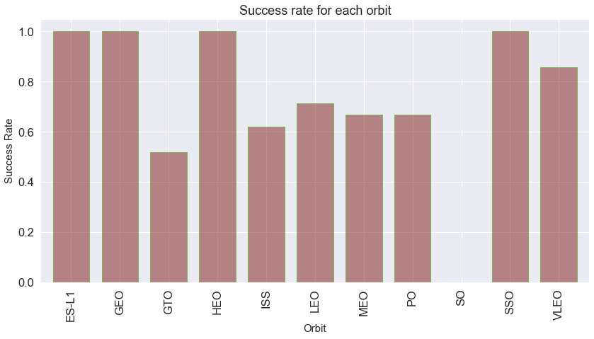
Success Rate vs. Orbit Type
Remarks:
GTO is a transfer orbit to GEO. Low thrust engines of the payload (satellite) complete the orbiting phase.
We ignore results: GEO, SO, HEO, ESL-1, MEO. The number of flights is not significant.
GTO sees the lowest success rate as suggested in previous slide.
SSO (polar low orbit) the highest one.
Success rate may strongly depend on both:
payload mass
orbit.
meaning the amount of energy deployed at lift-off, that may induce strong noise/vibrations that are known to damage satellites*.
Vibrations could damage some of the booster electronics, inertial guidance systems... and cause booster recovery/landing failure.
We also need additional info about payload mass/orbit. Fortunately it is available.
* https://adsabs.harvard.edu/full/1996ESASP.386..237F

Slide 25
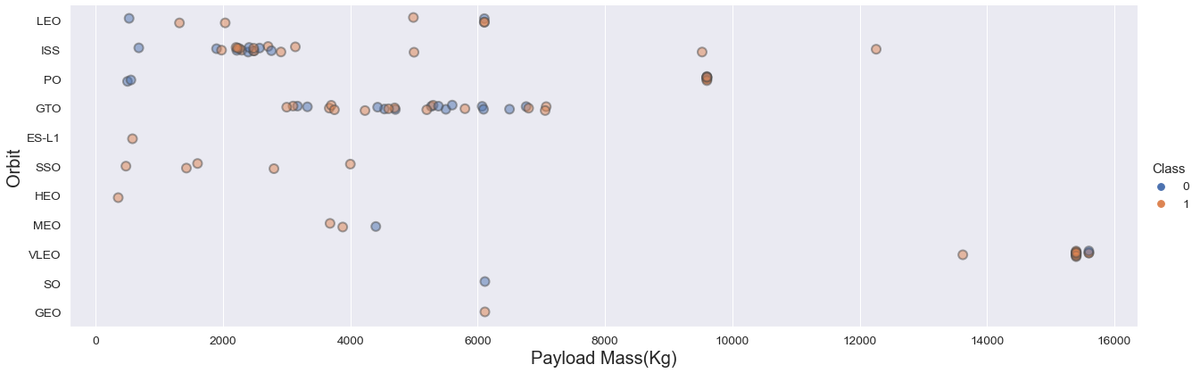
Orbit Type v. Payload
The chart brings final info about “Orbit v. Payload”. It describes the distribution “success rate v. (payload, orbit)”
Main trends:
Maximum success rate with: low orbit except (ISS) and low payload mass
ISS: based on “Orbit Type v. Flight Number” 5/8 failures occurred in the early stage of Falcon 9 project. When Falcon 9 reliability was low.
Between 2000 and 7500 kg, success rate seems to be evenly distributed for GTO.
Independently of payload mass, GTO is a risky “orbit” affecting missions success rate. Falcon 9 reliability improves over time, but there are still recent failed booster recovery after GTO launches.

Slide 26
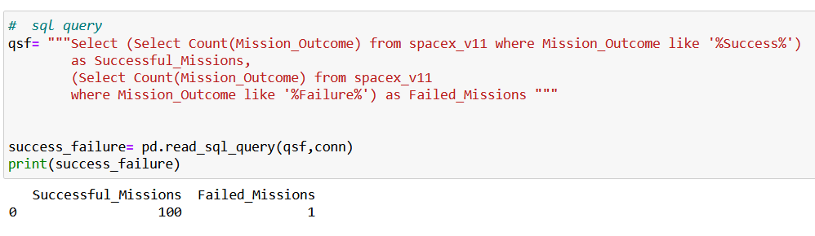
Total Number of Successful and Failure Mission Outcomes
Total number of successful and failure mission outcomes (from SQL queries).
Here success is defined based on properly launching/orbiting payload. Success rate is very high: ~99% like Ariane-5.
Nevertheless, Falcon9 maintains a competitive advantage in terms of cost per kg compared with classic launchers like Ariane-5, only if the reusable booster is recovered.
Therefore Falcon9 “success rate” in this report is defined after successful booster recovery (landing).

Slide 27
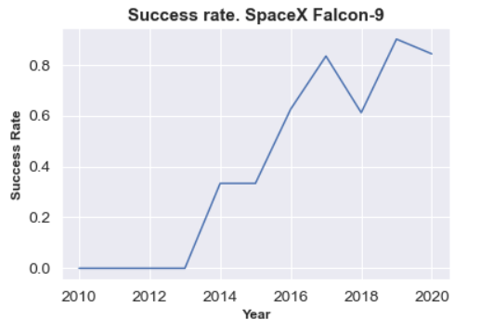
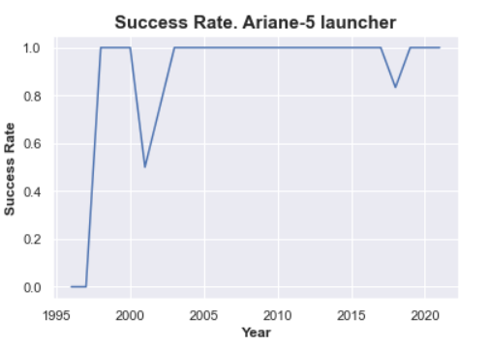
Launch Success Yearly Trend
Falcon 9 reliability significantly improves over time .
Success rate, here defined after successful booster recovery for Falcon9, depends on:
Payload mass
Orbit
+ other factors we investigate next
Independently of payload mass, orbits, Ariane 5 has a close to 100% success rate for 82 flights since 2003.
Falcon9 average booster recovery success rate si 66%.
Success rate currently sufficient for SpaceX financial viability.

Slide 28

Section 3
Launch Sites
Proximities Analysis

Slide 29
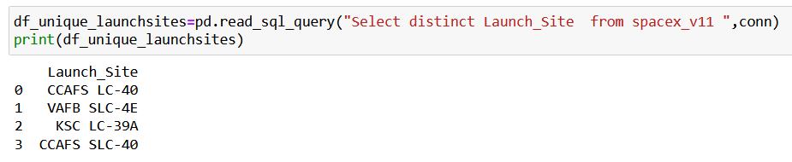
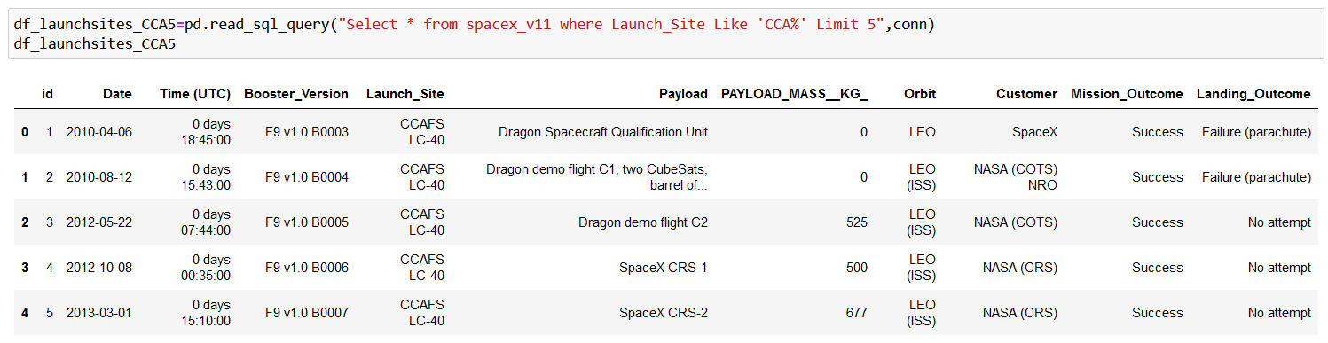
Launch Site Names & Records
Before starting launch sites analysis, we list the names of all launch sites and some launch records (from SQL queries).
5 records where launch sites begin with `CCA`
There are 4 distinct launch sites

Slide 30
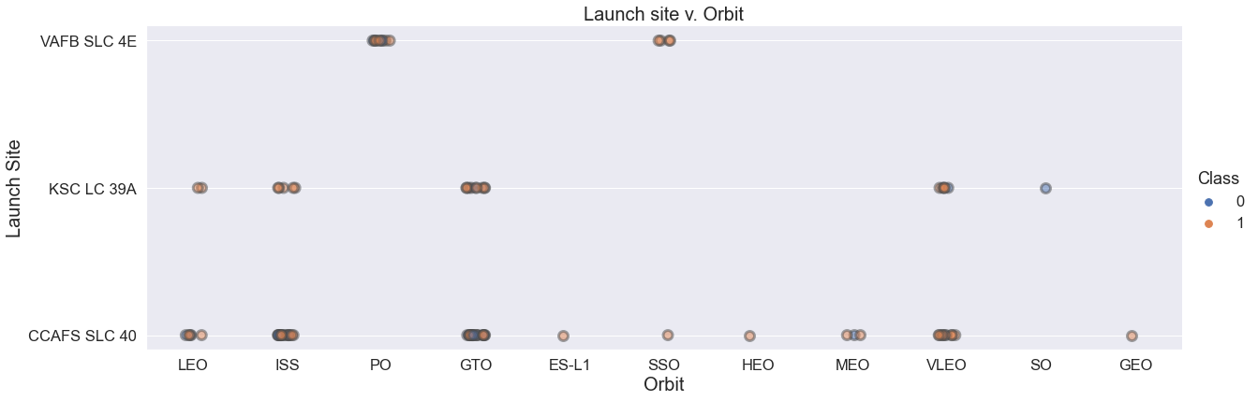
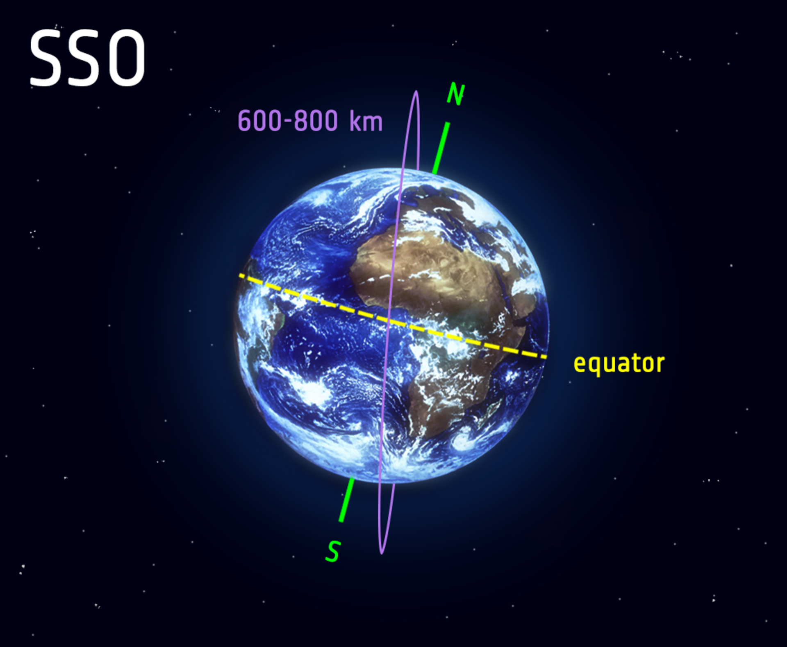

Launch site v. Orbit type
We added that scattered chart, which has implications in the analysis of launch sites.
VAFB SLC 4E launch site in California, is used only for PO and SSO orbits, meaning low altitude polar orbits. North or south? bound flights over the ocean.
All GTO/GEO launches take place in Florida launch sites. As close as possible to the equator where earth tangential velocity is maximum, acting like a slingshot at lift off, from west to east over the ocean. (see gif). This helps with orbiting GEO satellites with less energy.

Slide 31
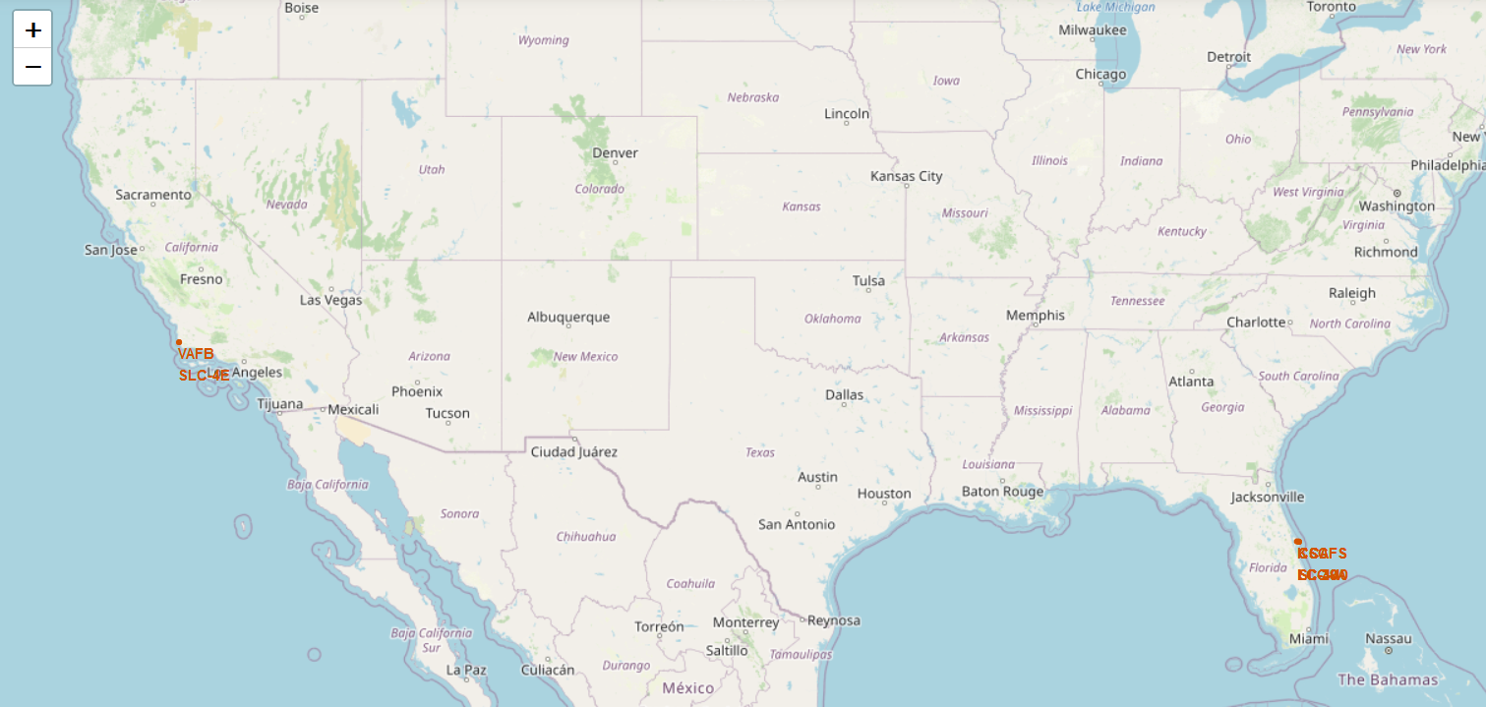
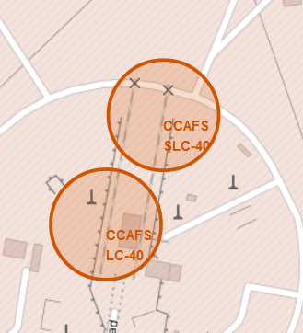
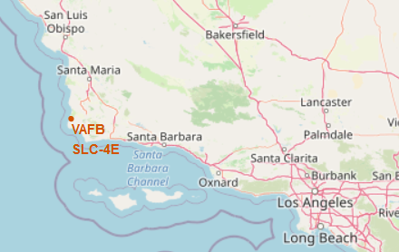
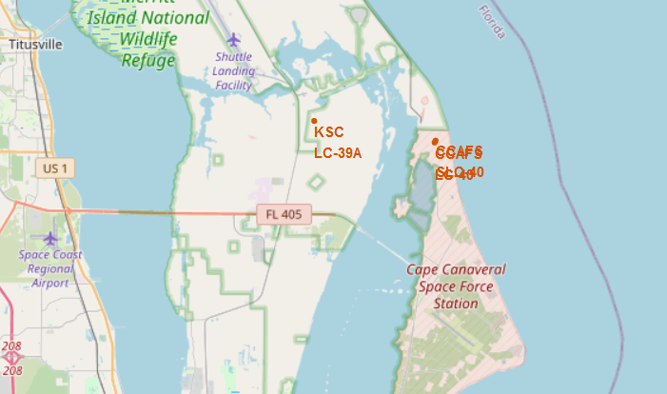
SpaceX: All launch sites
VAFB SLC-4E: Vandenberg Space Launch Complex 4 (CA)
KSC-LC29A: Kennedy Space Center - Merritt Island (FL)
CCAFS-LC40: Cape Canaveral Launch Complex 40 (FL)
CCAF-SLC40: Cape Canaveral Space Launch Complex 40(FL)

Slide 32
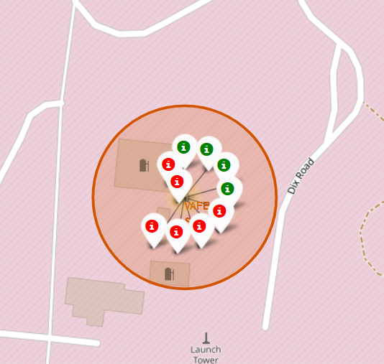
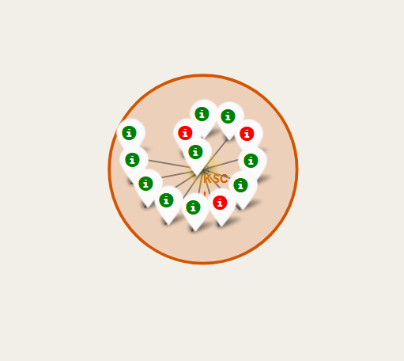
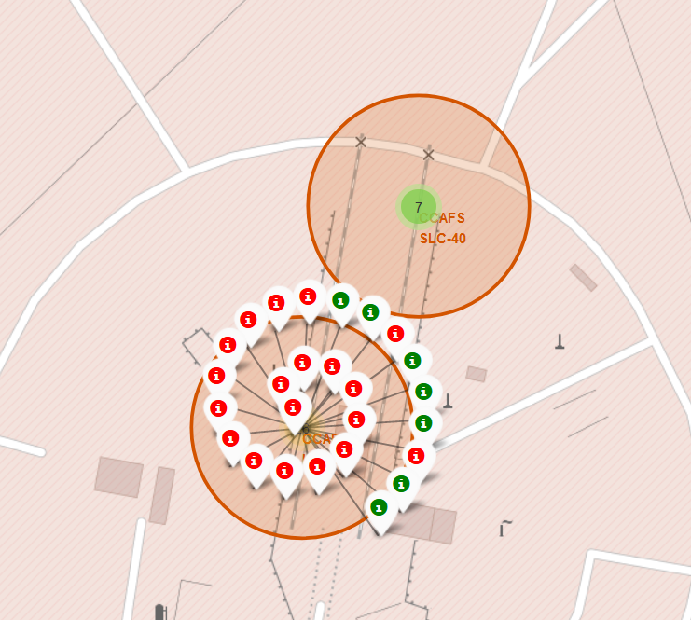
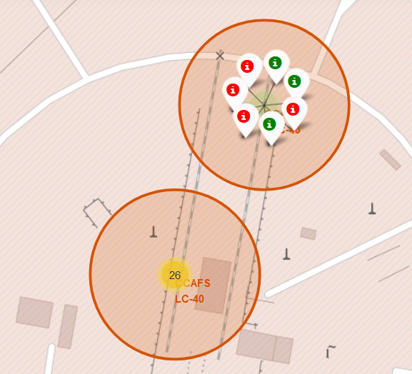
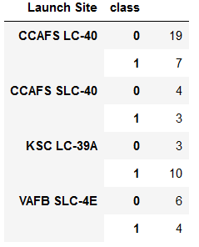
Falcon 9 Success/Failed launches for each site
Vandenberg Space Launch Complex 4 (CA)
VAFB SLC-4E
Kennedy Space Center (FL)
KSC LC 39A
Cape Canaveral (FL)
CCAFS-LC40
Cape Canaveral (FL)
CCAFS-SLC40
Table: Synthesis of launches outcomes
Class 0= failure
Class 1= success

Slide 33
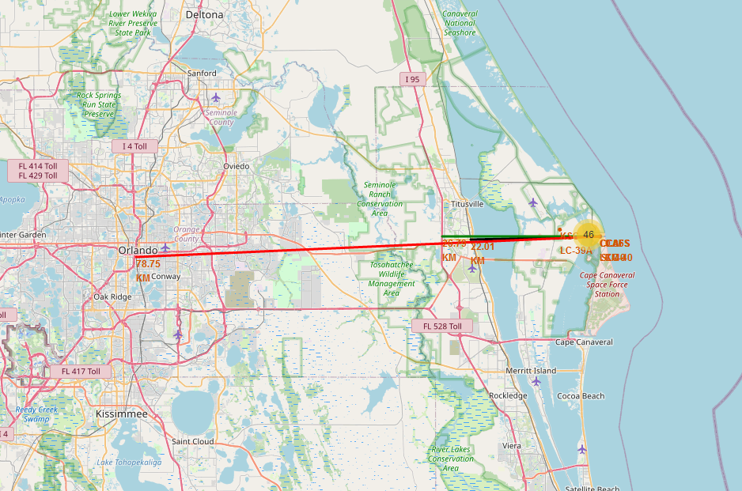
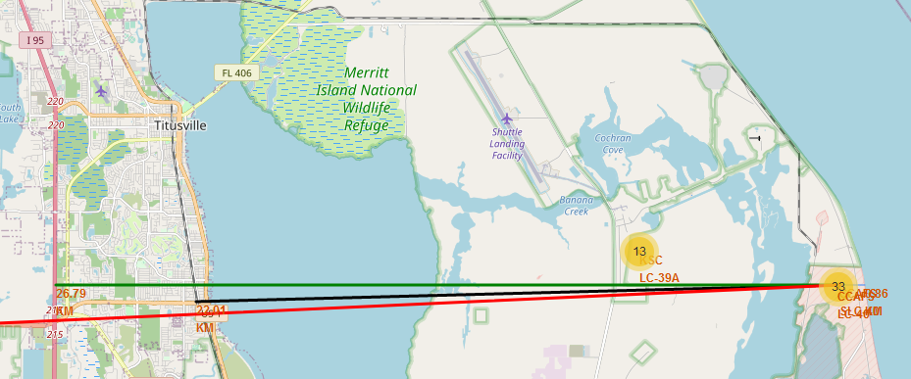
Distances between a launch site to its proximities
Distance from CCAFS_SLC40 to:
Closest coast: ~900 m
Florida East Coast Railway: 22.0 km
Highway I 95: 26.8 km
Orlando: 78.75 km
Launch sites are close to coasts. For safety issues if launcher is lost in the early stage of the flight.
Rockets are launched:
From West to East over the ocean in Florida.
North or South bound over the ocean in California. (Polar orbits only)
Launch sites are relatively far from populated areas for protecting population from serious incidents at lift off: explosion on the launch pad.
https://nbviewer.org/github/DrStef/Applied_Data_Science_Capstone/blob/main/GH_lab_jupyter_launch_site_location_v4.ipynb

Slide 34
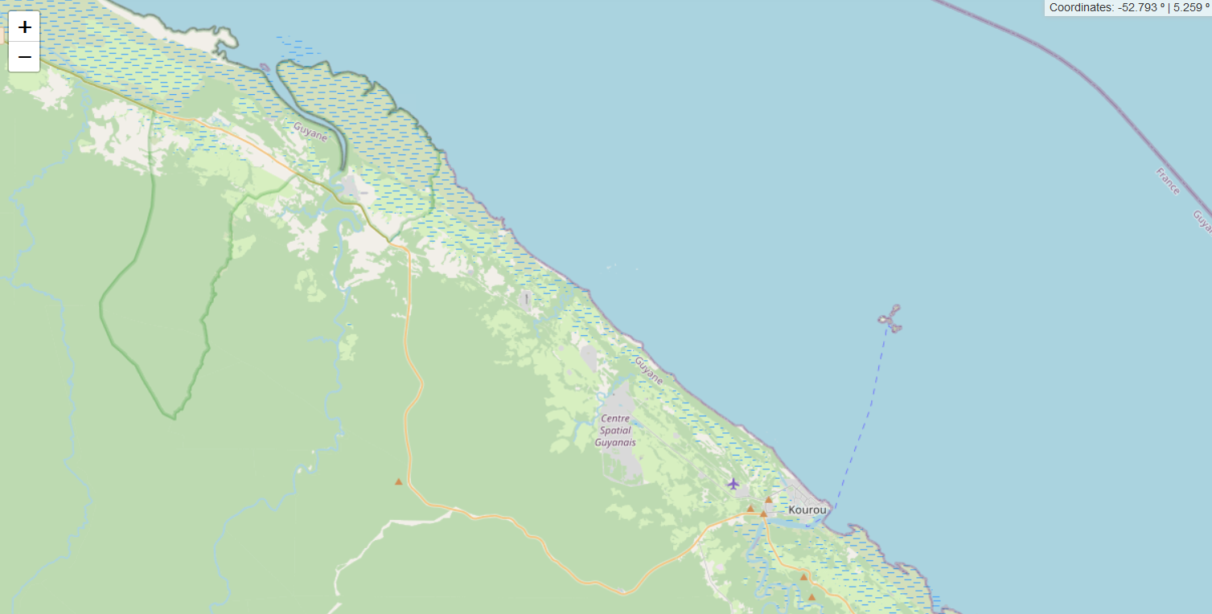
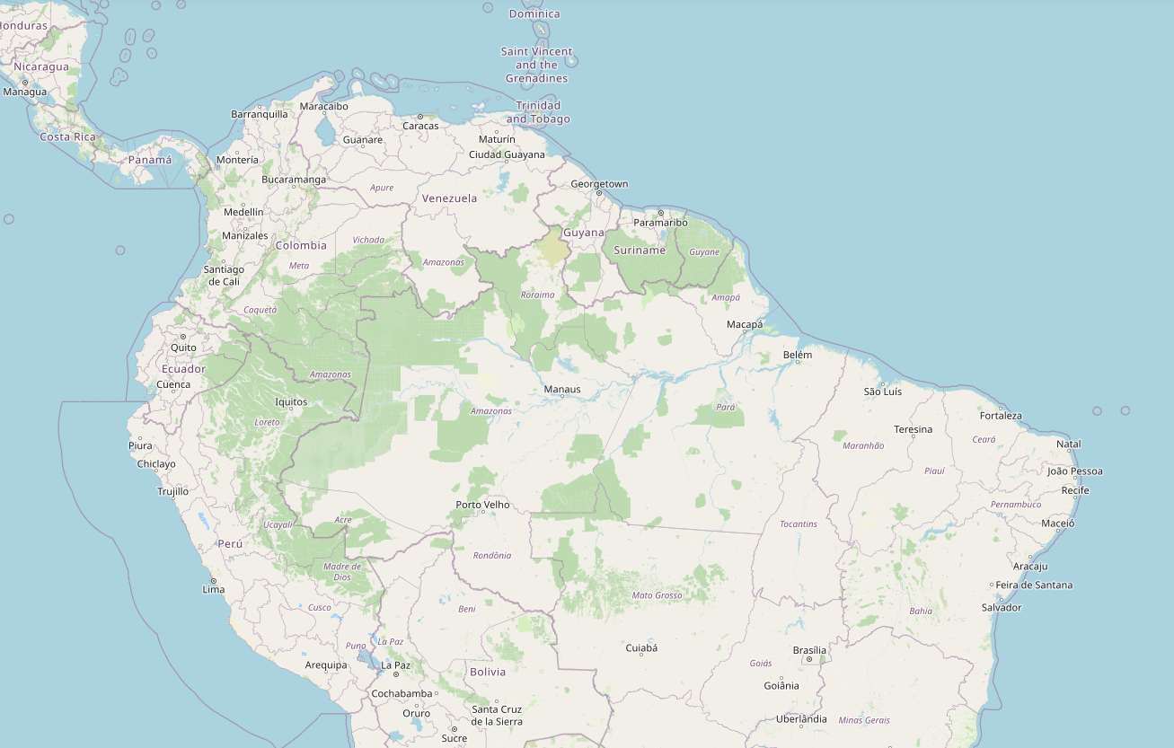
ESA Unique Launch site – Kourou, French Guiana.
European Space Agency (ESA)/ArianeEspace launch sites in Kourou, French Guiana (France).
Kourou launch sites: Ariane, Soyuz
are very close to the Equator: it’s a strong advantage for GTO/GEO flights
are in a remote area far from any high density inhabited area and high traffic infrastructures
Are close to the coast
Strong Advantage over SpaceX, in terms of safety and GTO/GEO flights and energy required at lift-off.
SpaceX could compete and reduce energy at lift-off for GTO-GEO flights by introducing a concept like “Sea Launch”.
Soyuz launch pad
Ariane launch pad

Slide 35
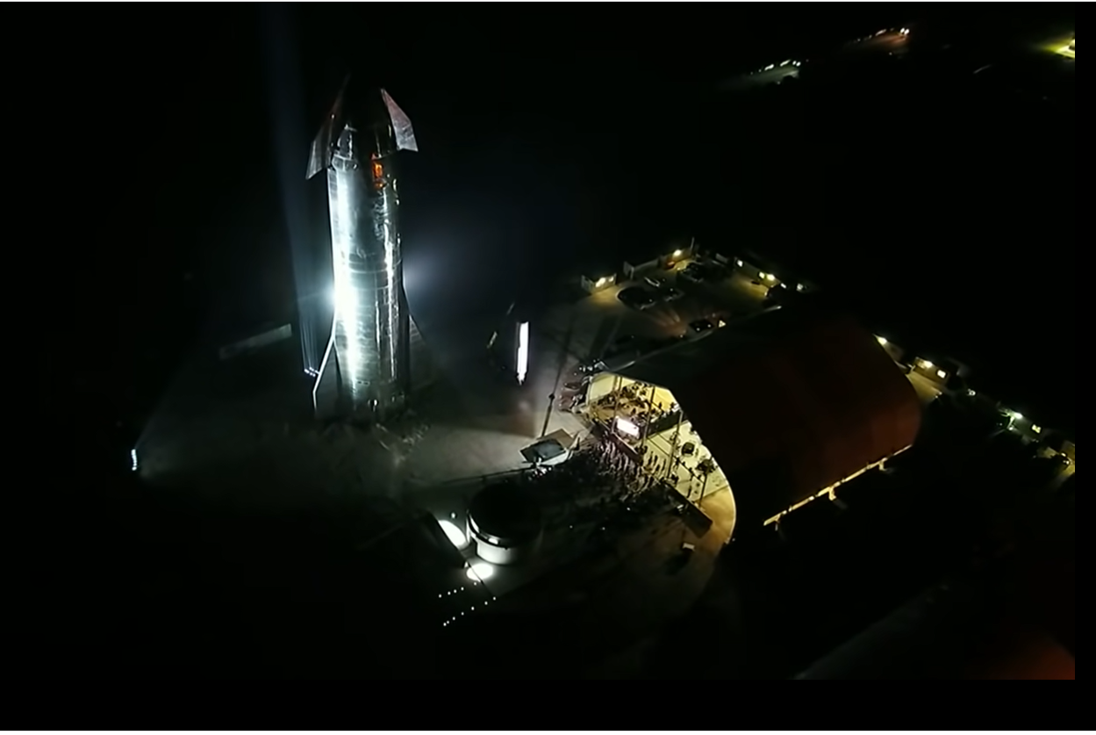
Section 3
Build a Dashboard
With Plotly Dash

Slide 36
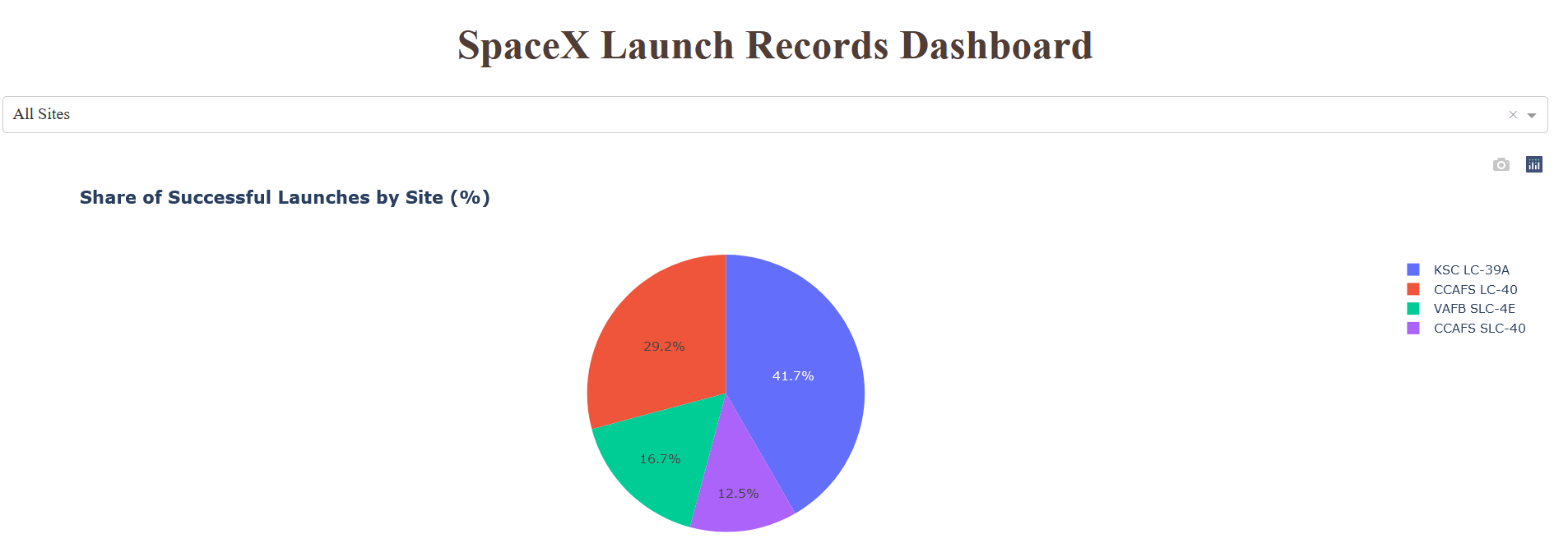
SpaceX Falcon 9: Launch success count for all sites
The dahsboard allows an interactive visualization and analysis of Falcon successful launches.
It completes scattered charts.
Here for all sites, we can identify the launch site with highest success rate.
Kennedy Space Center in Florida.

Slide 37
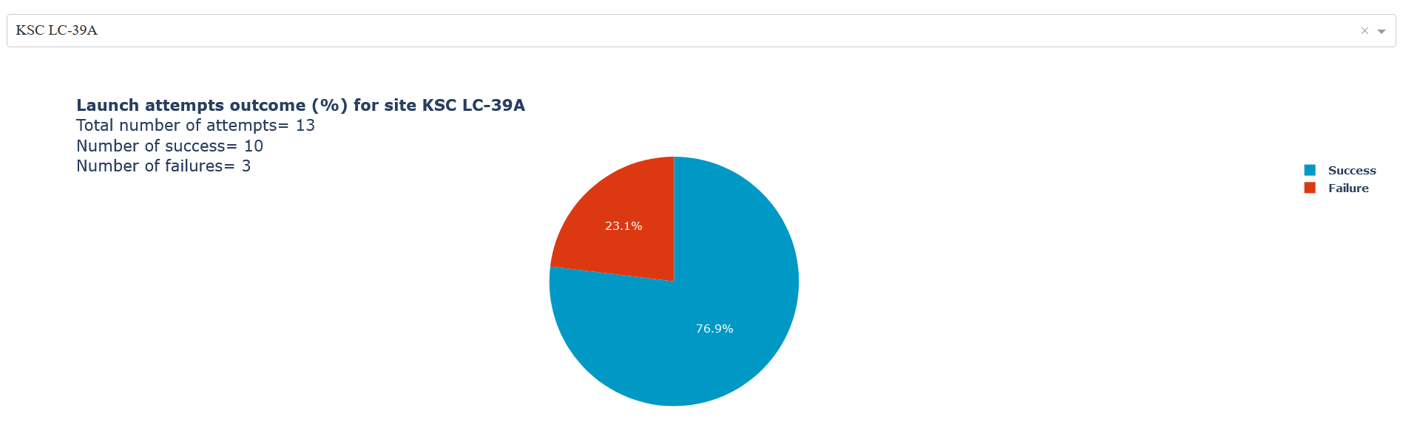
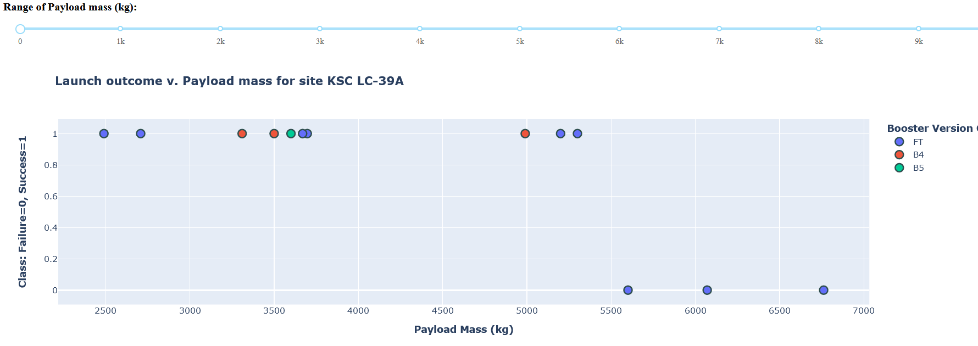
SpaceX Falcon9 Launch site with highest launch success ratio
KSC LC-39A
Kennedy Space Center in Florida.
13 flights, 10 successful missions.
Heavy payload are “high risk”
Success does not seem to depend upon boosters versions with low mass payload <5500kg.
B5 and FT are the most reused launchers. Data is not sufficient, but may indicates that they are as reliable as 1st time launchers.

Slide 38
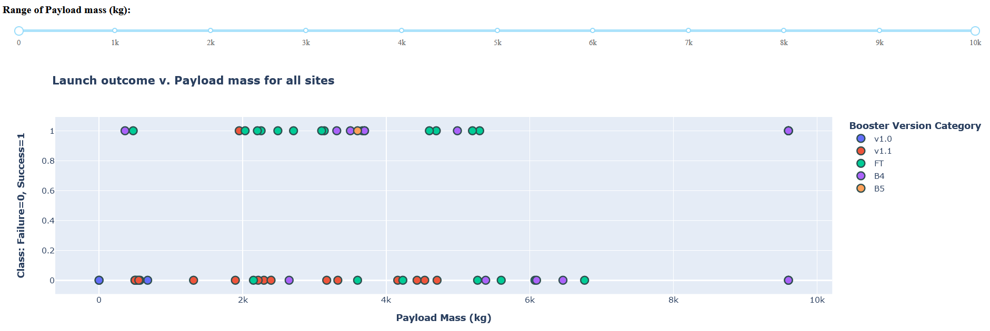
Launch outcome v. Payload mass (all sites)
V1.0 and v1.1 are early launchers with low reliability.
Landing legs, were pioneered on the Falcon 9 v1.1 version, but that version never landed intact.
They were phased out in 2015.
FT: “Full Thrust” is the next generation and has the highest success rate for payload mass under 6 tons. Including with “drone landing” (see details in next slide).
Many FT flights are done with reused launchers. And show good reliability.
Heavy payload are “high risk”.

Slide 39

Successful Drone Ship Landing with Payload mass between 4000 and 6000 kg
List the names of Falcon 9 boosters which have successfully landed on drone ship and had payload mass greater than 4000 but less than 6000 kg
Recent Full Thrust (FT) boosters exhibit the highest success rate on drone ship landing. Including with GTO flights.
It bodes well if SpaceX introduces a concept like “Sea Launch” for GTO launches at sea, close to the equator.

Slide 40

Section 5
Predictive Analysis
(Classification)

Slide 41

Classification Accuracy
Classification Accuracy with test set.
Results with “train test split” random_state=3
Optimization of SVM and LR hyper-parameters was refined for increasing accuracy with train set.
It did not necessarily improved accuracy with test set.
Test set is too small.
In our case, KNN exhibits the best accuracy: ~94%

Slide 42

Confusion Matrix
k-nearest neighbors algorithm (k-NN) is the best “predictor”
The model perfectly predicts mission failure
1 false negative for successful booster landing (recovery)

Slide 43
Conclusions

Slide 44
Conclusions
We defined success as a successful recovery process of Falcon9 booster.
From Falcon 9 and Wiki we imported data and developed tools for investigating factors driving successful booster recovery:
Payload, Orbit, Booster version, Launching sites…
Based on these features, we selected a supervised classification model capable of predicting launch outcome with a 94% accuracy.
Falcon9 booster recovery process is more risky than a classic launcher, but its success rate:
-increases overtime
-at 66%, it is sufficient for maintaining a competitive cost per kg compared with classic Ariane5 /Ariane 6.
SpaceX GEO/GTO flights are more risky.
Failure could be linked to energy deployed at lift-off, vibrations damaging of electronics, control systems of the booster.
ESA/ArianeEspace, Soyuz have an advantage in terms of launch site, on the equator: less energy is required for GTO/GEO flights.
SpaceX could improve GEO/GTO flights success with a concept like “Sea Launch” close to the equator.
Recent successes with FT boosters landing on “drone ship”, bodes well for such a solution.
Even with recent recovery failure for GTO/GEO, SpaceX will maintain a sufficient lead in terms of cost per kg. vs Ariane5 and the new Ariane 6. Starship may well crush further the competition if similar success rate is achieved.

Slide 45
References and Jupyter Notebooks
[1] https://arstechnica.com/science/2021/03/european-leaders-say-an-immediate-response-needed-to-the-rise-of-spacex/
[2] https://www.arianespace.com/vehicle/ariane-5/
[3] https://www.arianespace.com/wp-content/uploads/2020/06/Arianespace_Brochure_Ariane5_Sept2019.pdf
[4] https://www.arianespace.com/ariane-6/
[5] https://www.arianespace.com/wp-content/uploads/2020/06/Arianespace_Brochure_Ariane6_Sept2019.pdf
[6] https://www.inverse.com/innovation/ariane-6-vs-spacex
[7] https://adsabs.harvard.edu/full/1996ESASP.386..237F
https://github.com/DrStef/Applied_Data_Science_Capstone
https://github.com/DrStef/Applied_Data_Science_Capstone/blob/main/GH_jupyter-labs-spacex-data-collection-api_v5.ipynb
https://github.com/DrStef/Applied_Data_Science_Capstone/blob/main/GH_labs-jupyter-spacex-Data%20wrangling_v3.ipynb
https://github.com/DrStef/Applied_Data_Science_Capstone/blob/main/GH_jupyter-labs-eda-sql-coursera_v10.ipynb
https://github.com/DrStef/Applied_Data_Science_Capstone/blob/main/GH_jupyter-labs-eda-dataviz-v10.ipynb
https://github.com/DrStef/Applied_Data_Science_Capstone/blob/main/GH_SpaceX_Machine%20Learning%20Prediction_Part_5_v8_shuffling.ipynb
https://nbviewer.org/github/DrStef/Applied_Data_Science_Capstone/blob/main/GH_lab_jupyter_launch_site_location_v4.ipynb
https://github.com/DrStef/Applied_Data_Science_Capstone/blob/main/GH_jupyter-labs-webscraping_v4.ipynbhttps://github.com/DrStef/Applied_Data_Science_Capstone/blob/main/GH_Build_a_Dashboard_Application_with_Plotly_Dash_v10.ipynb
Extra web scraping for Ariane-5:
https://github.com/DrStef/Applied_Data_Science_Capstone/blob/main/Applied_Data_Science_Capstone_Extra_Web_Scraping_v1.ipynb

Slide 46
Appendix: SQL queries
Include any relevant assets like Python code snippets, SQL queries, charts, Notebook outputs, or data sets that you may have created during this project

Slide 47

Total Payload Mass
Calculate the total payload carried by boosters from NASA (2 methods)

Slide 48

Average Payload Mass by F9 v1.1
Calculate the average payload mass carried by booster version F9 v1.1

Slide 49

First Successful Ground Landing Date
Find the dates of the first successful landing outcome on ground pad

Slide 50

Boosters Carried Maximum Payload
List the names of the boosters which have carried the maximum payload mass

Slide 51

2015 Launch Records
List the failed landing_outcomes in drone ship, their booster versions, and launch site names for in year 2015

Slide 52

Rank Landing Outcomes Between 2010-06-04 and 2017-03-20
Rank the count of landing outcomes (such as Failure (drone ship) or Success (ground pad)) between the date 2010-06-04 and 2017-03-20, in descending order

Slide 53


Glossary
PO, SSO, GTO, GEO. From ESA website.

Slide 54

Thank you !

